Slide 1
Estimation for Software Project

Slide 2
Estimation for Software Project
A real need for software has been established; stakeholders are onboard, software engineers are ready to start, and the project is about to begin.
Project planning encompasses five major activities—estimation, scheduling, risk analysis, quality management planning, and change management planning.
Attempt to determine how much money, effort, resources, and time it will take to build a specific software-based system or product.
Software project managers—using information solicited from project stakeholders and software metrics data collected from past projects.

Slide 3
Estimation for Software Project
Estimation begins with a description of the scope of the problem.
The problem is then decomposed into a set of smaller problems, and each of these is estimated using historical data and experience.
Problem complexity and risk are considered before a final estimate is made.

Slide 4
Estimation for Software Project
Estimation of resources, cost, and schedule for a software engineering effort requires experience, access to good historical information (metrics), and the courage to commit to quantitative predictions when qualitative information is all that exists. Estimation carries inherent risk, and this risk leads to uncertainty.
Project complexity has a strong effect on the uncertainty inherent in planning.
Project size is another important factor that can affect the accuracy and efficacy of estimates.
The degree of structural uncertainty also has an effect on estimation risk.

Slide 5
Estimation for Software Project
The availability of historical information has a strong influence on estimation risk. By looking back, you can emulate things that worked and improve areas where problems arose.
When comprehensive software metrics are available for past projects, estimates can be made with greater assurance, and overall risk is reduced.
Estimation risk is measured by the degree of uncertainty in the quantitative estimates established for resources, cost, and schedule.
If project scope is poorly understood or project requirements are subject to change, uncertainty and estimation risk become dangerously high.

Slide 6
Estimation for Software Project
THE PROJECT PLANNING PROCESS
The objective of software project planning is to provide a framework that enables the manager to make reasonable estimates of resources, cost, and schedule.
In addition, estimates should attempt to define best-case and worst-case scenarios so that project outcomes can be bounded.
Although there is an inherent degree of uncertainty, the software team embarks on a plan that has been established as a consequence of these tasks. Therefore, the plan must be adapted and updated as the project proceeds.

Slide 7
Estimation for Software Project
Task Set for Project Planning
1. Establish project scope.
2. Determine feasibility.
3. Analyze risks
4. Define required resources.
a. Determine required human resources.
b. Define reusable software resources.
c. Identify environmental resources.
5. Estimate cost and effort.
a. Decompose the problem.

Slide 8
Estimation for Software Project
b. Develop two or more estimates using size, function points, process tasks, or use cases.
c. Reconcile the estimates.
6. Develop a project schedule.
a. Establish a meaningful task set.
b. Define a task network.
c. Use scheduling tools to develop a time-line chart.
d. Define schedule tracking mechanisms.

Slide 9
Estimation for Software Project
SOFTWARE SCOPE AND FEASIBILITY
Software scope describes the functions and features that are to be delivered to end users; the data that are input and output; the “content” that is presented to users as a consequence of using the software; and the performance, constraints, interfaces, and reliability that bound the system. Scope is defined using one of two techniques:
1. A narrative description of software scope is developed after communication with all stakeholders.
2. A set of use cases is developed by end users.

Slide 10
Estimation for Software Project
Functions described in the statement of scope are evaluated and in some cases refined to provide more detail prior to the beginning of estimation.
Because both cost and schedule estimates are functionally oriented, some degree of decomposition is often useful.
Performance considerations encompass processing and response time requirements.
Constraints identify limits placed on the software by external hardware, available memory, or other existing systems.

Slide 11
Estimation for Software Project
Once scope has been identified it is reasonable to ask: “Can we build software to meet this scope? Is the project feasible?”
Software feasibility has four solid dimensions:
Technology—Is a project technically feasible? Is it within the state of the art? Can defects be reduced to a level matching the application’s needs?
Finance—Is it financially feasible? Can development be completed at a cost the software organization, its client, or the market can afford?
Time—Will the project’s time-to-market beat the competition?
Resources—Does the organization have the resources needed to succeed?

Slide 12
Estimation for Software Project
RESOURCES
The second planning task is estimation of the resources required to accomplish the software development effort. The three major categories of software engineering resources—people, reusable software components, and the development environment.
Each resource is specified with four characteristics: description of the resource, a statement of availability, time when the resource will be required, and duration of time that the resource will be applied.
The last two characteristics can be viewed as a time window. Availability of the resource for a specified window must be established at the earliest practical time.

Slide 13
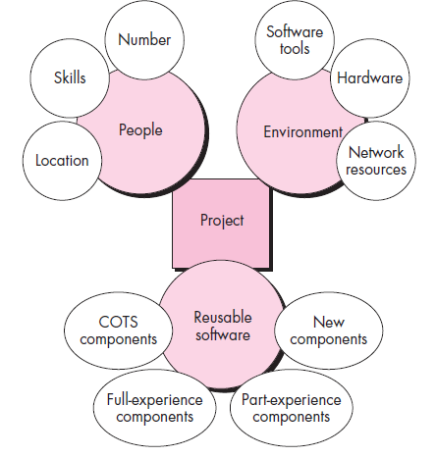
Estimation for Software Project

Slide 14
Estimation for Software Project
Human Resources
The planner begins by evaluating software scope and selecting the skills required to complete development.
Both organizational position (e.g., manager, senior software engineer) and specialty (e.g., telecommunications, database, client-server) are specified.
For relatively small projects, a single individual may perform all software engineering tasks, consulting with specialists as required. For larger projects, the software team may be geographically dispersed across a number of different locations.

Slide 15
Estimation for Software Project
The number of people required for a software project can be determined only after an estimate of development effort is made.
Reusable Software Resources
Component-based software engineering emphasizes reusability—that is, the creation and reuse of software building blocks.
Such building blocks, often called components, must be cataloged for easy reference, standardized for easy application, and validated for easy integration.

Slide 16
Estimation for Software Project
Bennatan suggests four software resource categories that should be considered as planning proceeds:
Off-the-shelf components: Existing software that can be acquired from a third party or from a past project. COTS (commercial off-the-shelf) components are purchased from a third party, are ready for use on the current project, and have been fully validated.
Full-experience components: Existing specifications, designs, code, or test data developed for past projects that are similar to the software to be built for the current project. Members of the current software team have had full experience in the application area represented by these components. Therefore, modifications required for full-experience components will be relatively low risk.

Slide 17
Estimation for Software Project
Partial-experience components: Existing specifications, designs, code, or test data developed for past projects that are related to the software to be built for the current project but will require substantial modification. Members of the current software team have only limited experience in the application area represented by these components. Therefore, modifications required for partial-experience components have a fair degree of risk.
New components: Software components must be built by the software team specifically for the needs of the current project.

Slide 18
Estimation for Software Project
Environmental Resources
The environment that supports a software project, often called the software engineering environment (SEE), incorporates hardware and software.
Hardware provides a platform that supports the tools (software) required to produce the work products that are an outcome of good software engineering practice.
Because most software organizations have multiple constituencies that require access to the SEE, you must prescribe the time window required for hardware and software and verify that these resources will be available.

Slide 19
Estimation for Software Project
When a computer-based system (incorporating specialized hardware and software) is to be engineered, the software team may require access to hardware elements being developed by other engineering teams. For example, software for a robotic device used within a manufacturing cell may require a specific robot (e.g., a robotic welder) as part of the validation test step.
Each hardware element must be specified as part of planning.

Slide 20
Estimation for Software Project
SOFTWARE PROJECT ESTIMATION
Too many variables—human, technical, environmental, political—can affect the ultimate cost of software and effort applied to develop it.
However, software project estimation can be transformed from a black art to a series of systematic steps that provide estimates with acceptable risk.

Slide 21
Estimation for Software Project
To achieve reliable cost and effort estimates, a number of options arise:
1. Delay estimation until late in the project.
2. Base estimates on similar projects that have already been completed.
3. Use relatively simple decomposition techniques to generate project cost and effort estimates.
4. Use one or more empirical models for software cost and effort estimation.

Slide 22
Estimation for Software Project
DECOMPOSITION TECHNIQUES
Software project estimation is a form of problem solving, and in most cases, the problem to be solved is too complex to be considered in one piece.
For this reason, you should decompose the problem, recharacterizing it as a set of smaller problems.
The decomposition approach can be discussed in two different points of view: decomposition of the problem and decomposition of the process.
Estimation uses one or both forms of partitioning. But before an estimate can be made, you must understand the scope of the software to be built and generate an estimate of its “size.”

Slide 23
Estimation for Software Project
Software Sizing
The accuracy of a software project estimate is predicated on a number of things:
(1) the degree to which you have properly estimated the size of the product to be built;
(2) the ability to translate the size estimate into human effort, calendar time, and dollars (a function of the availability of reliable software metrics from past projects);
(3) the degree to which the project plan reflects the abilities of the software team;
(4) the stability of product requirements and the environment that supports the software engineering effort.

Slide 24
Estimation for Software Project
Consider the software sizing problem. Because a project estimate is only as good as the estimate of the size of the work to be accomplished, sizing represents your first major challenge as a planner.
In the context of project planning, size refers to a quantifiable outcome of the software project.
If a direct approach is taken, size can be measured in lines of code (LOC).
If an indirect approach is chosen, size is represented as function points (FP).

Slide 25
Estimation for Software Project
Putnam and Myers suggest four different approaches to the sizing problem:
1) Fuzzy logic sizing: This approach uses the approximate reasoning techniques that are the foundation of fuzzy logic. To apply this approach, the planner must identify the type of application, establish its magnitude on a qualitative scale, and then refine the magnitude within the original range.
2) Function point sizing: The planner develops estimates of the information domain characteristics

Slide 26
Estimation for Software Project
Standard component sizing: Software is composed of a number of different “standard components” that are generic to a particular application area. For example, the standard components for an information system are subsystems, modules, screens, reports, interactive programs, batch programs, and LOC. The project planner estimates the number of occurrences of each standard component and then uses historical project data to estimate the delivered size per standard component.
Change sizing: This approach is used when a project encompasses the use of existing software that must be modified in some way as part of a project. The planner estimates the number and type (e.g., reuse, adding code, changing code, deleting code) of modifications that must be accomplished.

Slide 27
Estimation for Software Project
Problem-Based Estimation
Lines of code and function points were described as measures from which productivity metrics can be computed. LOC and FP data are used in two ways during software project estimation: (1) as estimation variables to “size” each element of the software and
(2) as baseline metrics collected from past projects and used in conjunction with estimation variables to develop cost and effort projections.

Slide 28
Estimation for Software Project
LOC and FP estimation are distinct estimation techniques. Yet both have a number of characteristics in common.
Begin with a bounded statement of software scope and from this statement attempt to decompose the statement of scope into problem functions that can each be estimated individually.
LOC or FP (the estimation variable) is then estimated for each function. Alternatively, may choose another component for sizing, such as classes or objects, changes, or business processes affected.

Slide 29
Estimation for Software Project
Baseline productivity metrics (e.g., LOC/pm or FP/pm) are then applied to the appropriate estimation variable, and cost or effort for the function is derived.
Function estimates are combined to produce an overall estimate for the entire project.
In general, LOC/pm or FP/pm averages should be computed by project domain.
That is, projects should be grouped by team size, application area, complexity, and other relevant parameters. Local domain averages should then be computed.

Slide 30
Estimation for Software Project
When a new project is estimated, it should first be allocated to a domain, and then the appropriate domain average for past productivity should be used in generating the estimate.
The LOC and FP estimation techniques differ in the level of detail required for decomposition and the target of the partitioning.
When LOC is used as the estimation variable, decomposition is absolutely essential and is often taken to considerable levels of detail.
The greater the degree of partitioning, the more likely reasonably accurate estimates of LOC can be developed.

Slide 31
Estimation for Software Project
For FP estimates, decomposition works differently. Rather than focusing on function, each of the information domain characteristics—inputs, outputs, data files, inquiries, and external interfaces complexity adjustment values are estimated.
The resultant estimates can then be used to derive an FP value that can be tied to past data and used to generate an estimate.

Slide 32

Estimation for Software Project
Three-point or expected value can then be computed. The expected value for the estimation variable (size) S can be computed as a weighted average of the optimistic (s_{opt}), most likely (s_{m}), and pessimistic (s_{pess}) estimates.

Slide 33
Estimation for Software Project
An Example of LOC-Based Estimation
The mechanical CAD software will accept two- and three-dimensional geometric data from an engineer. The engineer will interact and control the CAD system through a user interface that will exhibit characteristics of good human/machine interface design. All geometric data and other supporting information will be maintained in a CAD database. Design analysis modules will be developed to produce the required output, which will be displayed on a variety of graphics devices. The software will be designed to control and interact with peripheral devices that include a mouse, digitizer, laser printer, and plotter.

Slide 34
Estimation for Software Project
A range of LOC estimates is developed for each function.
For example, the range of LOC estimates for the 3D geometric analysis function is optimistic, 4600 LOC; most likely, 6900 LOC; and pessimistic, 8600 LOC. Applying Equation, the expected value for the 3D geometric analysis function is 6800 LOC. Other estimates are derived in a similar

Slide 35
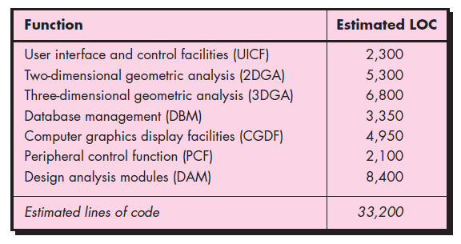
Estimation for Software Project

Slide 36
Estimation for Software Project
A review of historical data indicates that the organizational average productivity for systems of this type is 620 LOC/pm.
Based on a burdened labor rate of $8000 per month, the cost per line of code is approximately $13. Based on the LOC estimate and the historical productivity data, the total estimated project cost is $431,000 and the estimated effort is 54 person-months.

Slide 37
Estimation for Software Project
Process-Based Estimation
The most common technique for estimating a project is to base the estimate on the process that will be used. That is, the process is decomposed into a relatively small set of tasks and the effort required to accomplish each task is estimated.
A series of framework activities must be performed for each function.
Once problem functions and process activities are melded, estimate the effort (e.g., person-months) that will be required to accomplish each software process activity for each software function.

Slide 38
Estimation for Software Project
Data constitute the central matrix of the table in Figure. Average labor rates (i.e., cost/unit effort) are then applied to the effort estimated for each process activity.
It is very likely the labor rate will vary for each task. Senior staff are heavily involved in early framework activities and are generally more expensive than junior staff involved in construction and release.
Costs and effort for each function and framework activity are computed as the last step.

Slide 39
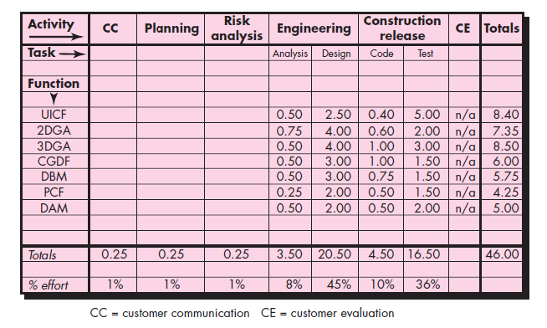
Estimation for Software Project

Slide 40
Estimation for Software Project
Estimation with Use Cases
Use cases provide a software team with insight into software scope and requirements.
Developing an estimation approach with use cases is problematic for the following reasons:
Use cases are described using many different formats and styles—there is no standard form.
Use cases represent an external view (the user’s view) of the software and can therefore be written at many different levels of abstraction.

Slide 41
Estimation for Software Project
Use cases do not address the complexity of the functions and features that are described.
Use cases can describe complex behavior (e.g., interactions) that involve many functions and features.
Unlike an LOC or a function point, one person’s “use case” may require months of effort while another person’s use case may be implemented in a day or two.
Although a number of investigators have considered use cases as an estimation input, no proven estimation method has emerged to date

Slide 42
Estimation for Software Project
Before use cases can be used for estimation, the level within the structural hierarchy is established, the average length (in pages) of each use case is determined, the type of software (e.g., real-time, business, engineering/scientific, WebApp, embedded) is defined, and a rough architecture for the system is considered.
Once these characteristics are established, empirical data may be used to establish the estimated number of LOC or FP per use case.
Historical data are then used to compute the effort required to develop the system.

Slide 43
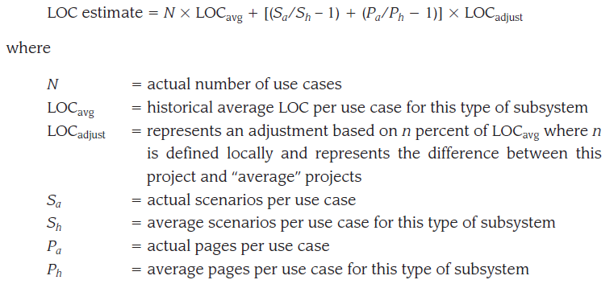
Estimation for Software Project

Slide 44
Estimation for Software Project
An Example of Use-Case–Based Estimation
Six use cases describe the user interface subsystem. Each use case is described by no more than 10 scenarios and has an average length of six pages.
The engineering subsystem group is described by 10 use cases.
Each of these use cases has no more than 20 scenarios associated with it and has an average length of eight pages. Finally, the infrastructure subsystem group is described by five use cases with an average of only six scenarios and an average length of five pages.

Slide 45
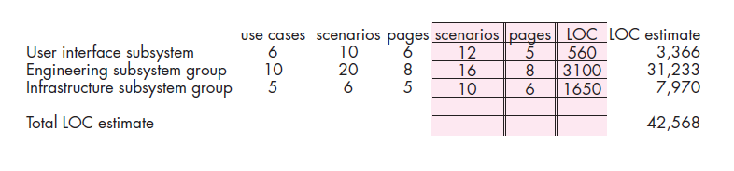
Estimation for Software Project

Slide 46
Estimation for Software Project
EMPIRICAL ESTIMATION MODELS
An estimation model for computer software uses empirically derived formulas to predict effort as a function of LOC or FP
The empirical data that support most estimation models are derived from a limited sample of projects.
An estimation model should be calibrated to reflect local conditions. The model should be tested by applying data collected from completed projects, plugging the data into the model, and then comparing actual to predicted results. If agreement is poor, the model must be tuned and retested before it can be used.

Slide 47

Estimation for Software Project
The Structure of Estimation Models
A typical estimation model is derived using regression analysis on data collected from past software projects. The overall structure of such models takes the form
where A, B, and C are empirically derived constants, E is effort in person-months, and ev is the estimation variable (either LOC or FP).

Slide 48
Estimation for Software Project
The COCOMO II Model
The original COCOMO model became one of the most widely used and discussed software cost estimation models in the industry. It has evolved into a more comprehensive estimation model, called COCOMOII.
COCOMO II is actually a hierarchy of estimation models that address the following areas:

Slide 49
Estimation for Software Project
Application composition model : Used during the early stages of software engineering, when prototyping of user interfaces, consideration of software and system interaction, assessment of performance, and evaluation of technology maturity are paramount.
Early design stage model : Used once requirements have been stabilized and basic software architecture has been established.
Post-architecture-stage model : Used during the construction of the software.

Slide 50
Estimation for Software Project
Like all estimation models for software, the COCOMO II models require sizing information. Three different sizing options are available as part of the model hierarchy: object points, function points, and lines of source code.
The COCOMO II application composition model uses object points .
Like function points, the object point is an indirect software measure that is computed using counts of the number of
screens (at the user interface),
reports, and
components likely to be required to build the application.

Slide 51
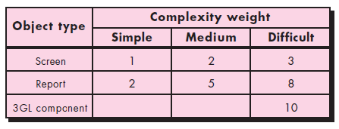
Estimation for Software Project
Each object instance (e.g., a screen or report) is classified into one of three complexity levels (i.e., simple, medium, or difficult)
Once complexity is determined, the number of screens, reports, and components are weighted
The object point count is then determined by multiplying the original number of object instances by the weighting factor in and summing to obtain a total object point count.

Slide 52
Estimation for Software Project
When component-based development or general software reuse is to be applied, the percent of reuse (%reuse) is estimated and the object point count is adjusted:
NOP=(object points)*[(100-%reuse)/100]
where NOP is defined as new object points.
To derive an estimate of effort based on the computed NOP value, a “productivity rate” must be derived.
PROD = NOP/Person-month

Slide 53
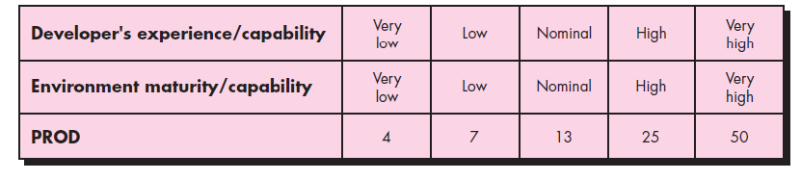
Estimation for Software Project
Once the productivity rate has been determined, an estimate of project effort is computed using
Estimated effort =NOP/ PROD

Slide 54
Estimation for Software Project
The Software Equation
The software equation is a dynamic multivariable model that assumes a specific distribution of effort over the life of a software development project.
The model has been derived from productivity data collected for over 4000 contemporary software projects. Based on these data, an estimation model is of the form

Slide 55
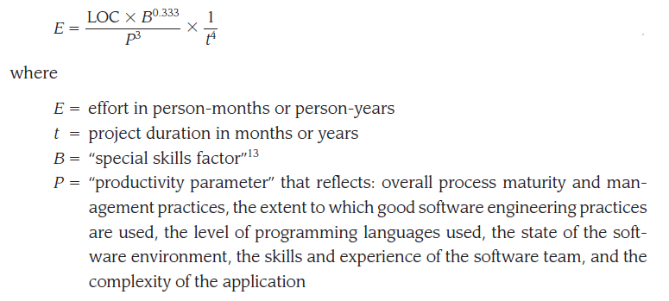
Estimation for Software Project

Slide 56
Estimation for Software Project
Typical values might be P=2000 for development of real-time embedded software, P=10,000 for telecommunication and systems software, and P=28,000 for business systems applications.
The productivity parameter can be derived for local conditions using historical data collected from past development efforts.
B increases slowly as the need for integration, testing, quality assurance, documentation, and management skills grows. For small programs (KLOC=5 to 15), B=0.16. For programs greater than 70 KLOC, B=0.39.
The software equation has two independent parameters:
an estimate of size (in LOC) and
an indication of project duration in calendar months or years.

Slide 57
Estimation for Software Project
ESTIMATION FOR OBJECT-ORIENTED PROJECTS
Methods has been designed explicitly for OO software such as
1. Develop estimates using effort decomposition, FP analysis, and any other method that is applicable for conventional applications.
2. Using the requirements model, develop use cases and determine a count. Recognize that the number of use cases may change as the project progresses.
3. From the requirements model, determine the number of key classes .
4. Categorize the type of interface for the application and develop a multiplier for support classes.

Slide 58
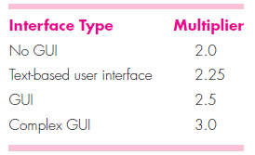
Estimation for Software Project
5. Multiply the total number of classes (key + support) by the average number of work units per class
6. Cross-check the class-based estimate by multiplying the average number of work units per use case.

Slide 59
Estimation for Software Project
SPECIALIZED ESTIMATION TECHNIQUES
Estimation for Agile Development
Estimation for agile projects uses a decomposition approach that encompasses the following steps:
1. Each user scenario (the equivalent of a mini use case created at the very start of a project by end users or other stakeholders) is considered separately for estimation purposes.
2. The scenario is decomposed into the set of software engineering tasks that will be required to develop it.

Slide 60
Estimation for Software Project
3a. The effort required for each task is estimated separately. Note: Estimation can be based on historical data, an empirical model, or experience.
3b. Alternatively, the volume of the scenario can be estimated in LOC or FP.
4a. Estimates for each task are summed to create an estimate for the scenario.
4b. Alternatively, the volume estimate for the scenario is translated into effort using historical data.
5. The effort estimates for all scenarios that are to be implemented for a given software increment are summed to develop the effort estimate for the increment.

Slide 61
Estimation for Software Project
THE MAKE/BUY DECISION
In many software application areas, it is often more cost effective to acquire rather than develop computer software. Software engineering managers are faced with a make/ buy decision that can be further complicated by a number of acquisition options:
Software may be purchased (or licensed) off-the-shelf,
Full-experience or partial-experience software components may be acquired and then modified and integrated to meet specific needs.
Software may be custom built by an outside contractor to meet the purchaser’s specifications.

Slide 62
Estimation for Software Project
In the final analysis, the make/buy decision is made based on the following conditions:
(1) Will the delivery date of the software product be sooner than that for internally developed software?
(2) Will the cost of acquisition plus the cost of customization be less than the cost of developing the software internally?
(3) Will the cost of outside support (e.g., a maintenance contract) be less than the cost f internal support? These conditions apply for each of the acquisition options.

Slide 63
Estimation for Software Project
Creating a Decision Tree
The steps just described can be augmented using statistical techniques such as decision tree analysis. In this case, the software engineering organization can
(1) Build system X from scratch.
(2) Reuse existing partial-experience components to construct the system.
(3) Buy an available software product and modify it to meet local needs.
(4) Contract the software development to an outside vendor.

Slide 64
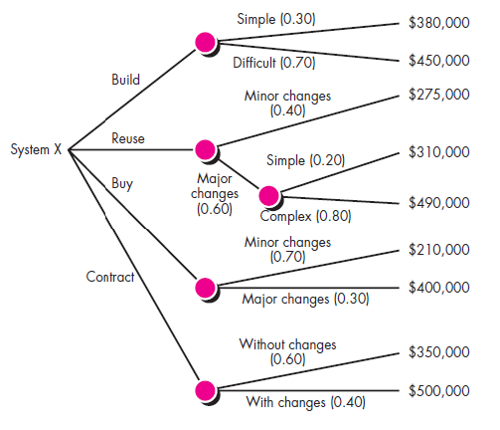
Estimation for Software Project

Slide 65
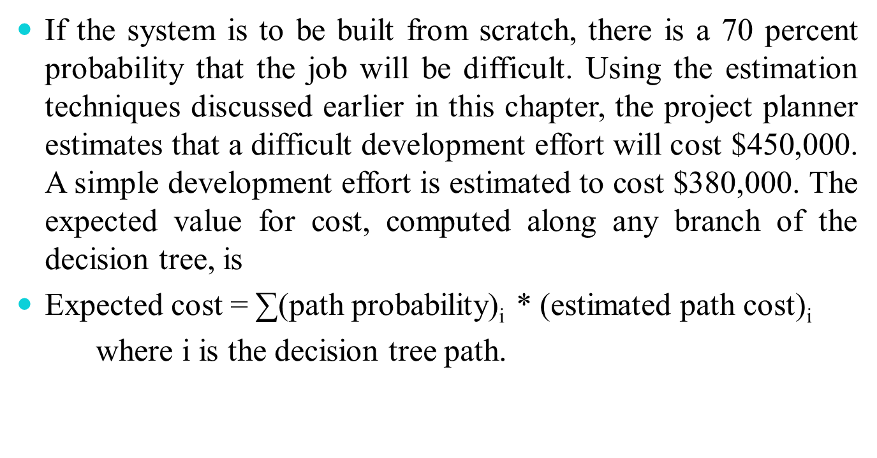
If the system is to be built from scratch, there is a 70 percent probability that the job will be difficult. Using the estimation techniques discussed earlier in this chapter, the project planner estimates that a difficult development effort will cost $450,000. A simple development effort is estimated to cost $380,000. The expected value for cost, computed along any branch of the decision tree, is
Expected cost = ∑(path probability)_{i} * (estimated path cost)_{i}
where i is the decision tree path.

Slide 66
For the build path,
Expected cost_{build} = 0.30 ($380K)+0.70 ($450K) = $429K
Following other paths of the decision tree, the projected costs for reuse, purchase, and contract, under a variety of circumstances, are also shown. The expected costs for these paths are
Expected cost_{reuse} = 0.40($275K)+0.60[0.20($310K)
+0.80($490K)] = $382K
Expected cost_{buy} = 0.70($210K) + 0.30 ($400K) = $267K
Expected cost_{contract} = 0.60 ($350K) + 0.40 ($500K) = $410K
Based on the probability and projected costs that have been noted in Decision Tree , the lowest expected cost is the “buy” option.
Based on this ultimate decision is taken.

Slide 67
Outsourcing
Outsourcing is extremely simple.
Software engineering activities are contracted to a third party who dose the work at lower cost and, hopefully, higher quality.
The decision to outsource can be either strategic or tactical.
At the strategic level, business managers consider whether a significant portion of all software work can be contracted to others.
At the tactical level, a project manager determines whether part or all of a project can be best accomplished by subcontracting the software work.

